Slide 1
Image Features (I)
Dr. Chang Shu
COMP 4900C
Winter 2008

Slide 2
Image Features
Image features – may appear in two contexts:
  Global properties of the image (average gray level, etc) – global features
  Parts of the image with special properties (line, circle, textured region) – local features
Here, assume second context for image features:
  Local, meaningful, detectable parts of the image
Detection of image features
  Detection algorithms – produce feature descriptors
  Example – line segment descriptor: coordinates of mid-point, length, orientation

Slide 3


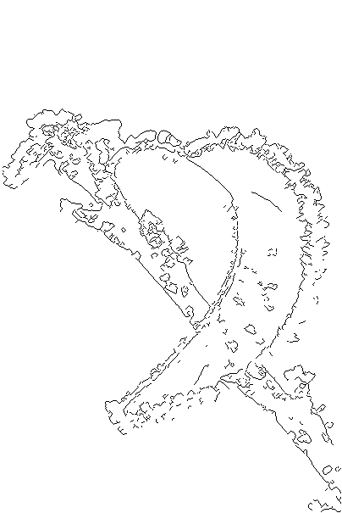

Edges in Images
Definition of edges
  Edges are significant local changes of intensity in an image.
  Edges typically occur on the boundary between two different regions in an image.

Slide 4
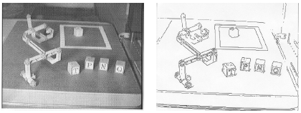
Applications of Edge Detection
  Produce a line drawing of a scene from an image of that scene.
  Important features can be extracted from the edges of an image (e.g. corners, lines, curves).
  These features are used by higher-level computer vision algorithms (e.g., segmentation, recognition).

Slide 5
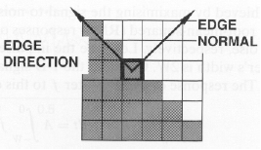
Edge Descriptors
  Edge normal: unit vector in the direction of maximum intensity change.
  Edge direction: unit vector to perpendicular to the edge normal.
  Edge position or center: the image position at which the edge is located.
  Edge strength: related to the local image contrast along the normal.

Slide 6
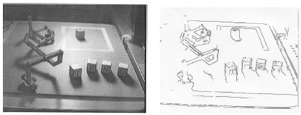
What causes intensity changes?
  Geometric events
    object boundary (discontinuity in depth and/or surface color and texture)
    surface boundary (discontinuity in surface orientation and/or surface color and texture)
  Non-geometric events
    specularity
    shadows (from other objects or from the same object)
    inter-reflections

Slide 7
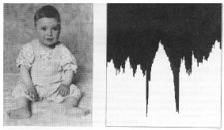
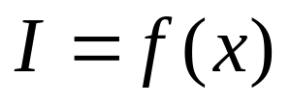
Images as Functions
1-D

Slide 8

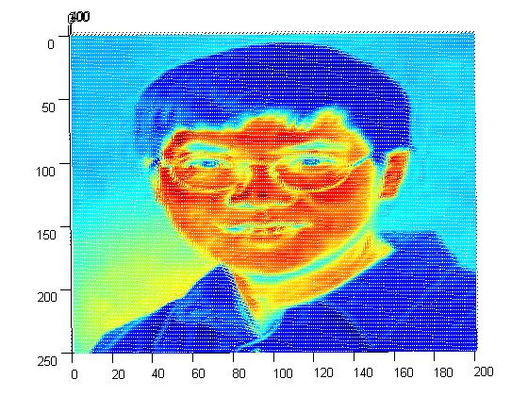
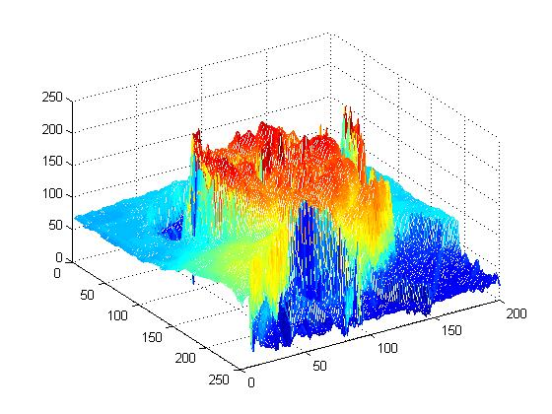
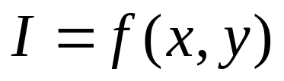
Images as Functions
2-D
Red channel intensity

Slide 9
Edge Detection using Derivatives
  Calculus describes changes of continuous functions using derivatives.
  An image is a 2D function, so operators describing edges are expressed using partial derivatives.
  Points which lie on an edge can be detected by either:
    detecting local maxima or minima of the first derivative
    detecting the zero-crossing of the second derivative

Slide 10
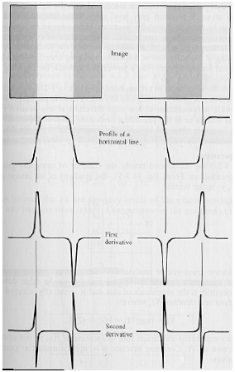
Edge Detection Using Derivatives
image
profile of a
horizontal line
first derivative
second derivative

Slide 11
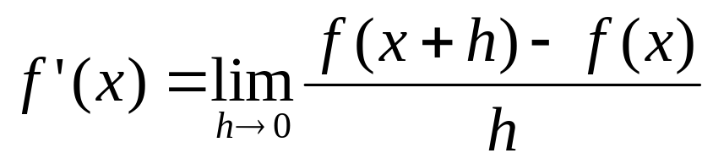


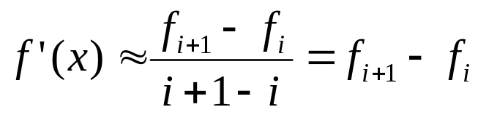

Finite Difference Method
We approximate derivatives with differences.
Derivative for 1-D signals:
Continuous function
Discrete approximation

Slide 12
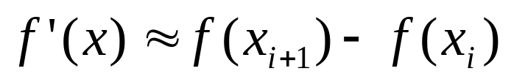
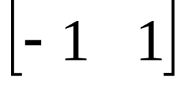
Finite Difference and Convolution
Finite difference on a 1-D image
is equivalent to convolving with kernel:

Slide 13
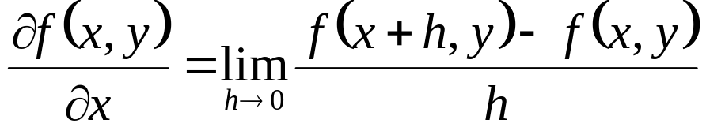
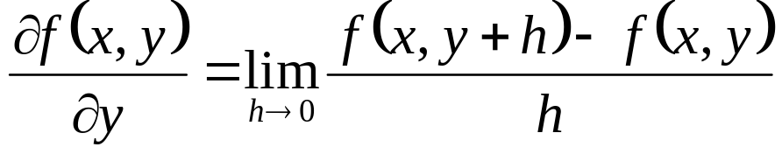
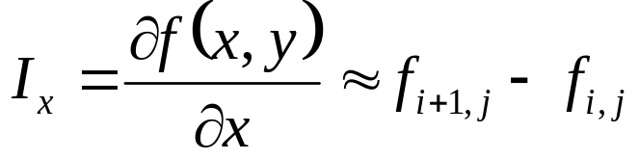

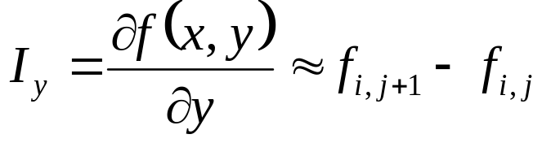
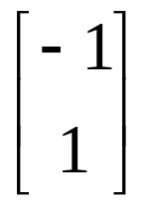
Finite Difference – 2D
Continuous function:
Discrete approximation:
Convolution kernels:

Slide 14

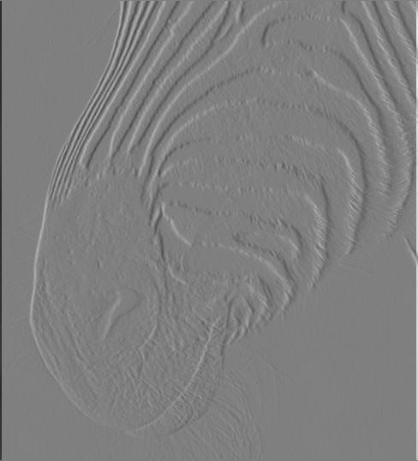

Image Derivatives
Image I

Slide 15
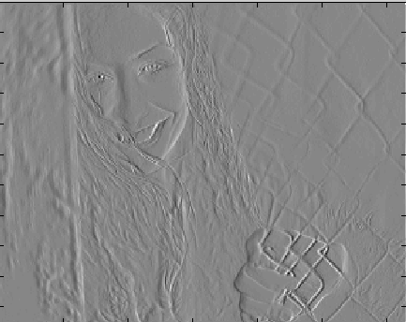

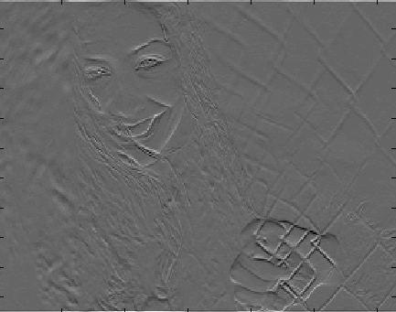
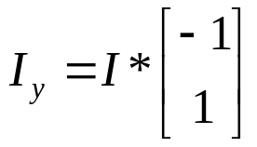
Image Derivatives
Image I

